Slide 1




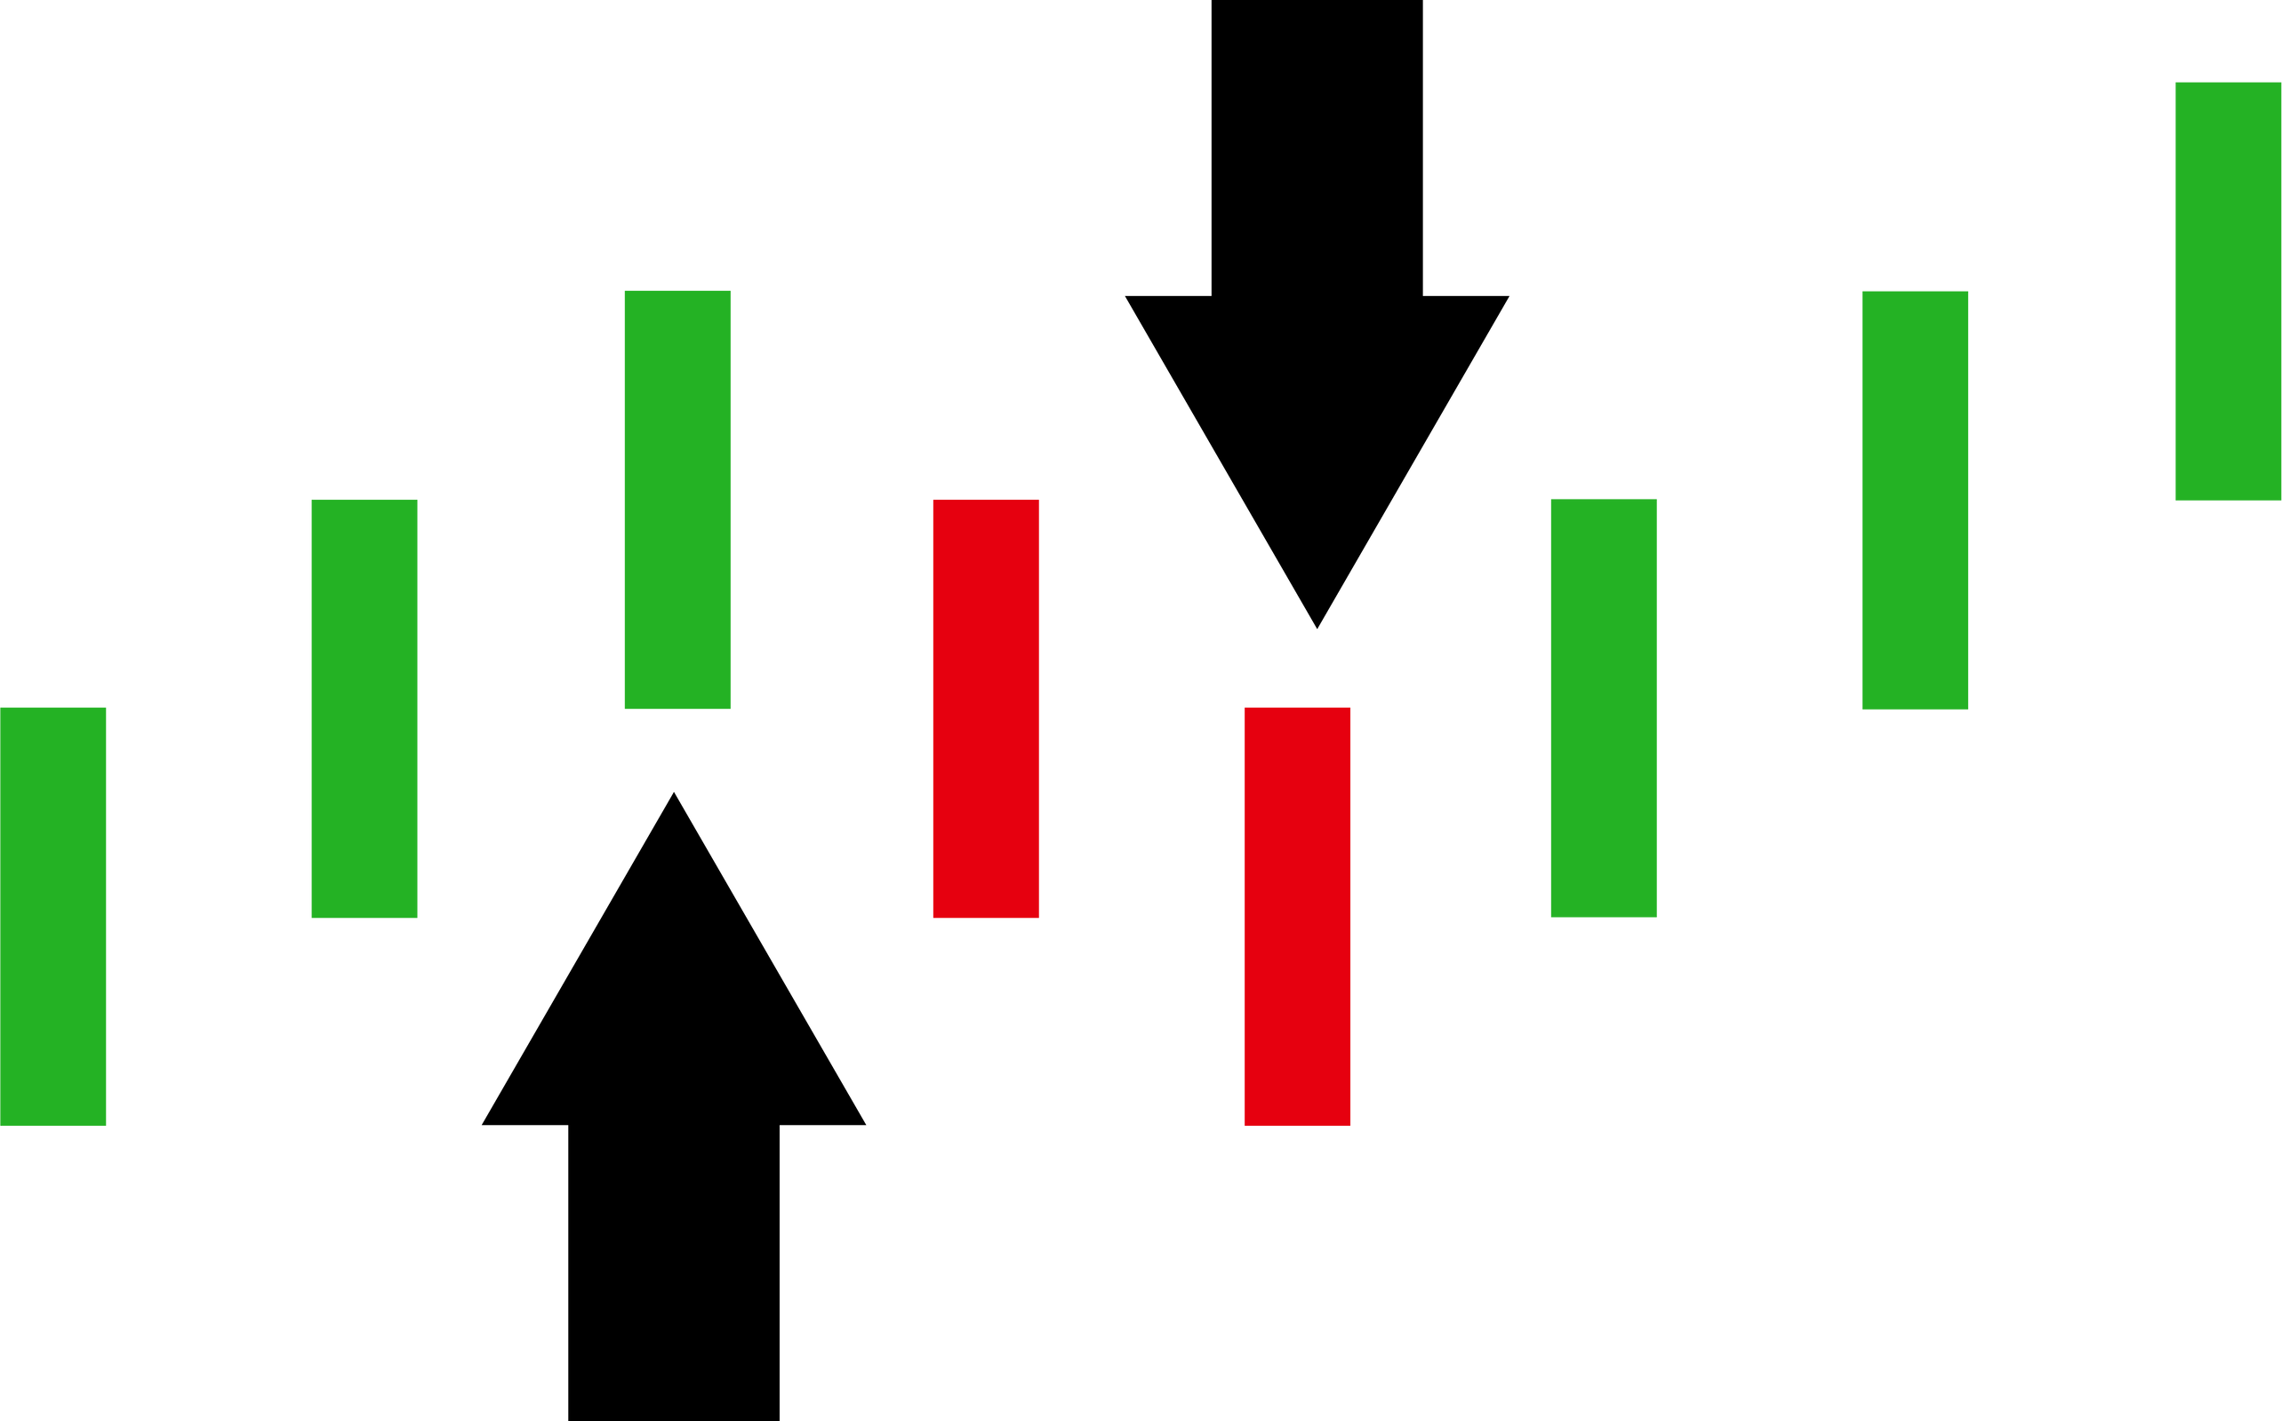
Enhancing Option Trading Predictions On
NIFTY-
50
Using Ensemble Technique
OPTION_TRADING.COM
By : Praveen Choudhary | Guided By: Sahil Shah
Prn : 23070243065

Slide 2


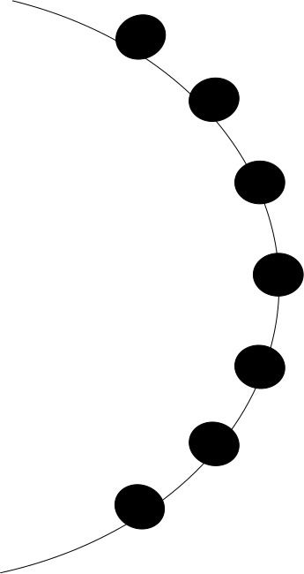



1
Introduction
2
Aims and Objectives
3
Data Description
Table of Contents
4
Workflow
5
Methodology
6
Results/Findings
7
Buy-Sell Indicator
8
Future Scope

Slide 3

INTRODUCTION:

Slide 4

WHAT IS NIFTY-50 ?
Nifty 50 option trading is a financial market where options based on the Nifty 50 index are bought and sold.
It operates during market hours on trading days, typically from Monday to Friday, and offers opportunities across different time frames.
Like forex, Nifty 50 option trading allows profit-making chances in both rising and falling markets, depending on the strategies used.

Slide 5
AIMS AND OBJECTIVES:

Slide 6








Aims and Objectives
Develop a Predictive Model for Nifty - 50 Close Price Movements.
01
02
Compare performance of LSTM, GRU and Hybrid LSTM-GRU model.
A
I
M
S
Generate Buy-Sell Signals based on Model forecasts
04
03
Forecasting Next 5 min. Close Prices

Slide 7
ABOUT THE DATASET:
date | open | high | low | close
09-01-2015 09:15 | 8285.45 | 8295.9 | 8285.45 | 8292.1
09-01-2015 09:16 | 8292.6 | 8293.6 | 8287.2 | 8288.15
09-01-2015 09:17 | 8287.4 | 8293.9 | 8287.4 | 8293.9
09-01-2015 09:18 | 8294.25 | 8300.65 | 8293.9 | 8300.65
09-01-2015 09:19 | 8300.6 | 8301.3 | 8298.75 | 8301.2
09-01-2015 09:20 | 8300.5 | 8303 | 8298.6 | 8300
09-01-2015 09:21 | 8300.65 | 8302.9 | 8300 | 8301.85
09-01-2015 09:22 | 8302.45 | 8302.45 | 8295 | 8295
09-01-2015 09:23 | 8294.85 | 8295.35 | 8293.25 | 8294.7
09-01-2015 09:24 | 8295.2 | 8302.55 | 8294.7 | 8301
Case | 836,758
Column | 5
Time Frame | Jan 2015 To jan 2024
Time Interval | 1 min
Source | Kaggle (Data Source)

Slide 8
DATA PREPARATION:

Slide 9
Technical Indicator | Description
Date-Time | convert our 1-minute dataset into a 5-minute dataset
M.A.C.D | Moving Average Convergence/Divergence (MACD) helps investors identify price trends, market sentiment, and momentum.
Average Price | Represents the average price of the financial instrument over a given time frame
Upper Bollinger Band | Indicates potential overbought levels by adding the standard deviation to the moving average.
Lower Bollinger Band | Signals potential oversold levels by subtracting the standard deviation from the moving average.
Close Price | Represents the Close price of nifty- 50 per 5 min.
Relative Strength Index : | A momentum oscillator that measures the speed and change of price movements, indicating overbought or oversold conditions in the market.
Feature Engineering
After feature engineering, we have, 167,366 rows and 11 columns.

Slide 10
WORKFLOW:

Slide 11


Workflow:
STANDALONE LSTM
Machine 1
STANDALONE GRU
Machine 2
BUY / SELL / HOLD INDICATORS
Data
PREDICTION
HYBRID MODEL
Machine 3

Slide 12
METHODOLOGY:

Slide 13
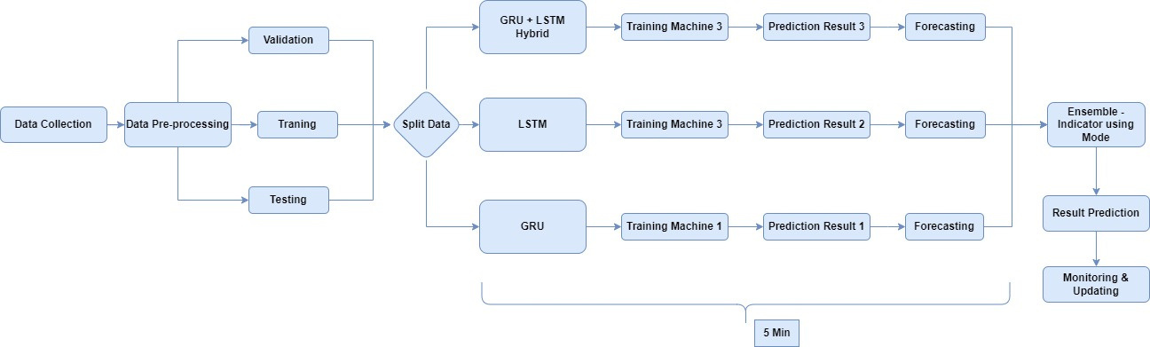
FlowChart:
Fig: Flowchart.

Slide 14
Applications including NLP, speech recognition, and financial forecasting.
It is a type of recurrent neural network (RNN).
Using its gates, It automatically save or remove stored memory.
What is an LSTM?
Designed to handle the sequence data.
Consists of Memory Cells, Forget Gate, Input Gate, Output Gate.
Handles Long-Term Dependencies.

Slide 15
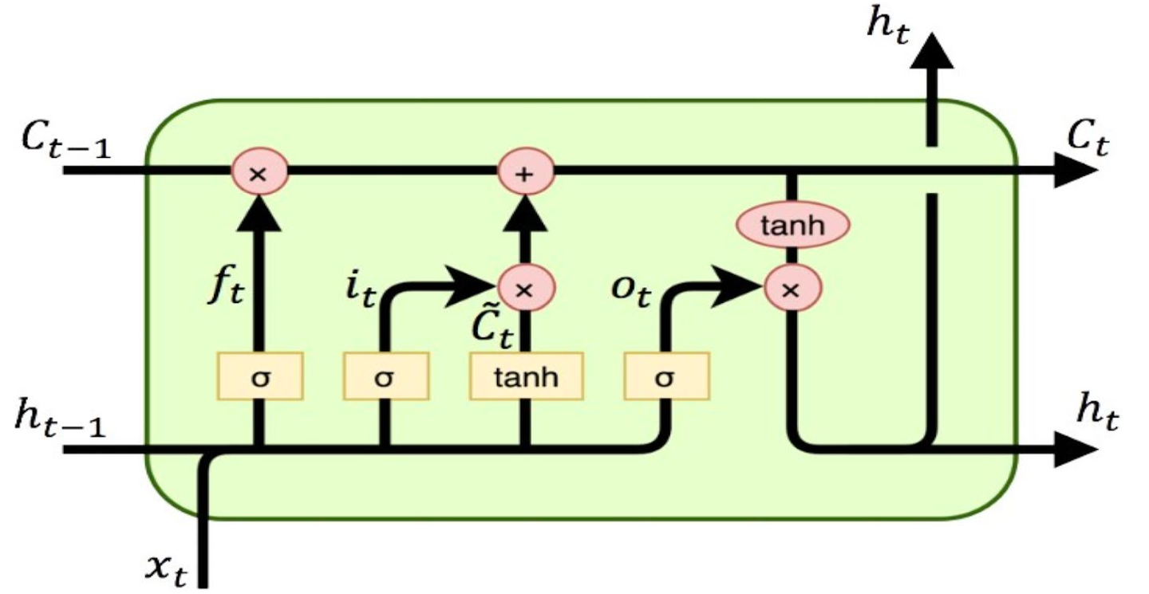
LSTM Model Architecture
Only meaningful context will pass through an output.
Cell State
Previous
output
Output
Input
(Source: LSTM )

Slide 16
Applications: NLP, speech recognition, time series prediction.
GRU: A simpler RNN with fewer gates than LSTM.
What is a GRU?
Better generalization with limited data.
Features: Update Gate, Reset Gate. Hidden State
Ideal for resource-constrained applications
Efficient, easier to train, and faster to converge than LSTM.

Slide 17
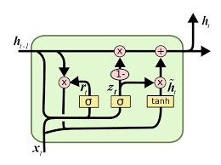
GRU Model Architecture
ht−1​: represents the hidden state at the previous time step t-1
ht​: represents the hidden state at the current time step t
rt​: ​ represents the reset gate at time step t.
zt​: represents the update gate at time step t.
xt​: ​ represents the input at time step t
h~t​: represents the candidate hidden state at time step t. It's the new information proposed to be added to the hidden state.
(Source : GRU)

Slide 18
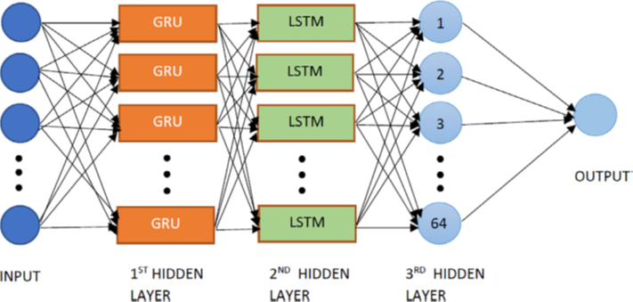
GRU+LSTM Hybrid Model Architecture
(Source : GRU+LSTM) :
also use hybrid LSTM-GRU model combines LSTM's memory retention with GRU's efficiency, offering improved performance and faster training.

Slide 19
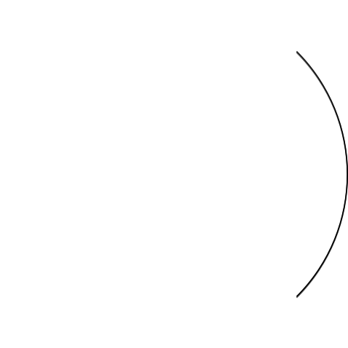


Indicator Signal’s
Buy
UB < Close > LB & MB < Close > LB
INDICATOR
Sell
UB > Close < LB & MB > Close < LB
Hold
UB > Close > LB & MB > Close < LB

Slide 20
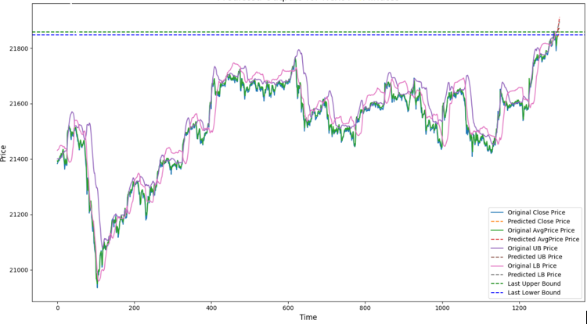
Chart For Analysis Indicator
Fig: Chart For Analysis Indicator For Buy/ Sell/ Hold Signal.

Slide 21
Training:

Slide 22
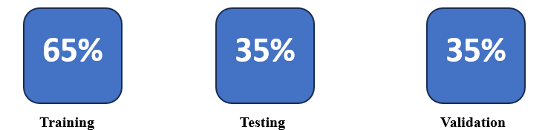
Training Model Dataset
Case | 787
Column | 4
Days | 10 Days
Time Interval | 5 min
Source | Kaggle (Data Source)

Slide 23
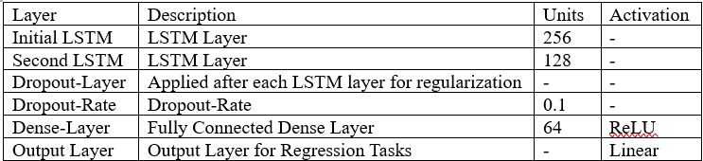
LSTM Model
Table: The table in the image shows the output units and activation for each layer in the LSTM model.
There are 5 total layers in the LSTM model.
The first layer is an LSTM layer with 256 units. This is followed by a dropout layer, which is used to prevent overfitting.
The second LSTM layer has 128 units and is also followed by a dropout layer.
The final two layers are dense layers. The first dense layer has 64units, and the second dense layer has 1 unit.

Slide 24
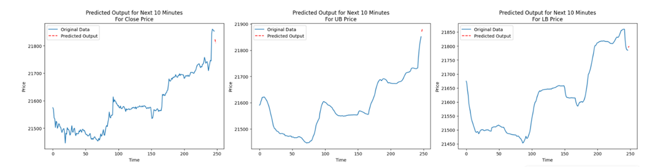
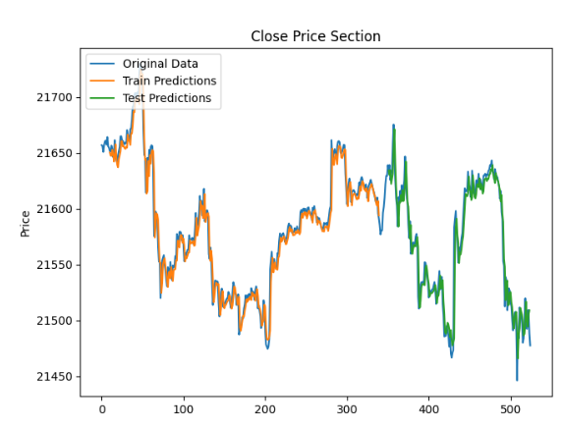
LSTM Model
Fig: Training vs Testing Performance
Fig: Predicted Point Of Close, LB and UB

Slide 25
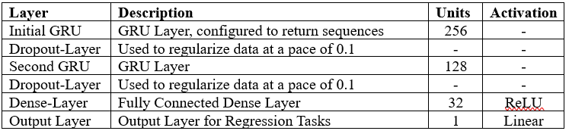
GRU Model
Table: The table in the image shows the output units and activation for each layer in the GRU model.
There are 6 total layers in the GRU model.
The first layer is an GRU layer with 256 units. This is followed by a dropout layer, which is used to prevent overfitting.
The second GRU layer has 128 units and is also followed by a dropout layer.
The final two layers are dense layers. The first dense layer has 32 units, and the second dense layer has 1 unit.

Slide 26
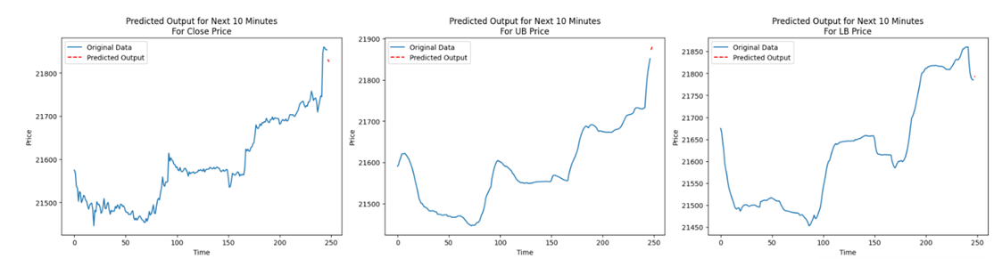
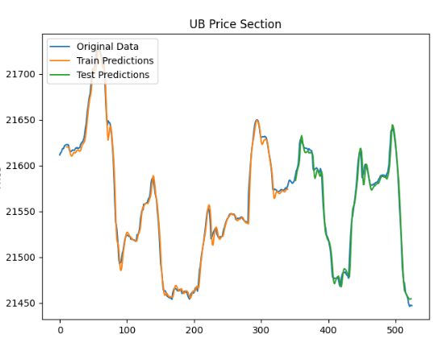
GRU Model
Fig: Training vs Testing Performance
Fig: Predicted Point Of Close, LB and UB

Slide 27
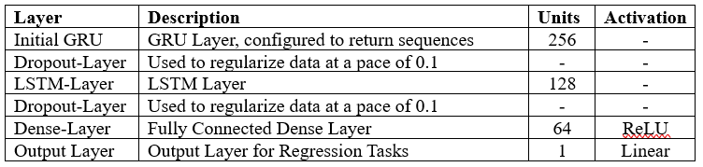
Hybrid LSTM-GRU Model
Table: The table in the image shows the output units and activation for each layer in the Hybrid model.
There are 6 total layers in the GRU model.
The first layer is an GRU layer with 256 units. This is followed by a dropout layer, which is used to prevent overfitting.
The second LSTM layer has 128 units and is also followed by a dropout layer.
•The final two layers are dense layers. The first dense layer has 64 units, and the second dense layer has 1 unit.

Slide 28
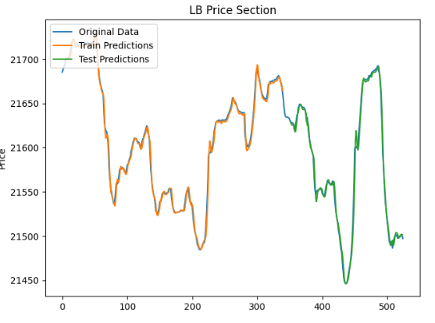
Hybrid LSTM-GRU Model
Fig: Training vs Testing Performance
Fig: Predicted Point Of Close, LB and UB

Slide 29
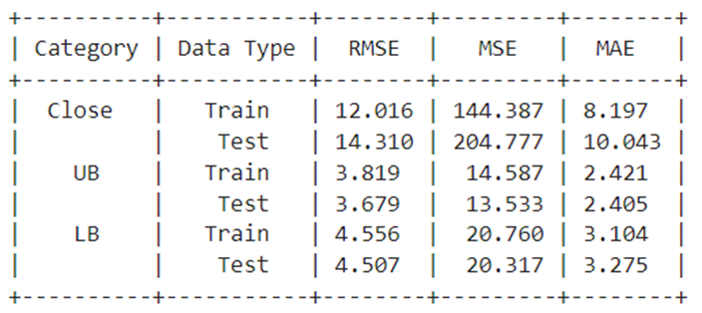
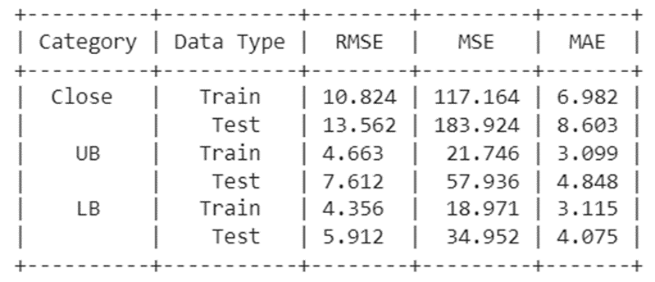
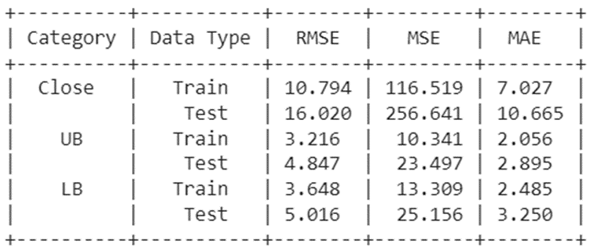
Model Comparison
LSTM
GRU
LSTM + GRU (Hybrid)
The LSTM, GRU, LSTM-GRU Hybrid all Model exhibits the lowest values for MSE, MAE. In training and testing. indicating its superior performance and making accurate predictions.

Slide 30
FUTURE PREDICTIONS:

Slide 31

Problem faced:
Since the model takes all 11 features as input and forecasts the value of only a single feature, it was difficult to iterate it up to a certain value. So, the PROBLEM arises what to write the value of other features for that particular timestamp?
Since we have 3 features to forecast with all 3 models, the problem is that we have a short time limit. In total, we have 9 models (3 models × 3 features). How to forecast all of them with good accuracy?

Slide 32
FUTURE PREDICTIONS
To forecast the next 10 min of close prices using the all three model.
Step 1
Initially, the model was trained to predict closing prices based on learned weights.
Step 2
Same, separate models were developed for forecasting Upper and lower band prices.
Step 3
Perform Step 1 and Step 2 twice more: once for GRU and once for the LSTM+GRU hybrid model.
Step 4
By implementing these steps, the first set of forecasted Close prices was generated.
Step 5
To extend the forecast for the subsequent 2-time steps, a function was constructed, iterating through the steps to derive the Close prices for the next 10 min.

Slide 33
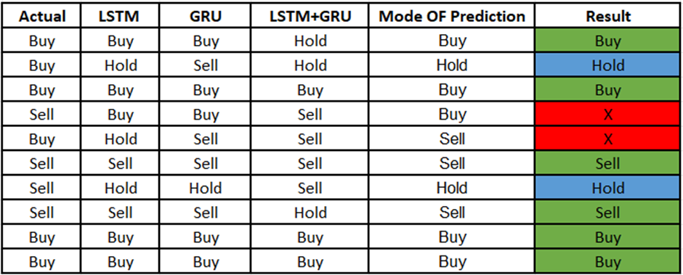


Result
60%
40%

Slide 34
Conclusion:

Slide 35
Conclusion:
Three models (GRU, LSTM, Hybrid GRU + LSTM) were proposed and tested to forecast 5-minute interval Nifty-50 index price fluctuations. The models achieved an average accuracy of 60%, correctly predicting market movements 6 out of 10 times.
The model includes a “Hold” signal, which makes up 20% of all signals, allowing for reduced risk exposure. This helps avoid unnecessary trades during volatile market conditions, preserving capital and minimizing potential losses.
The system's conservative approach prevents trades when market signals are unclear, providing a buffer against making poor decisions.

Slide 36
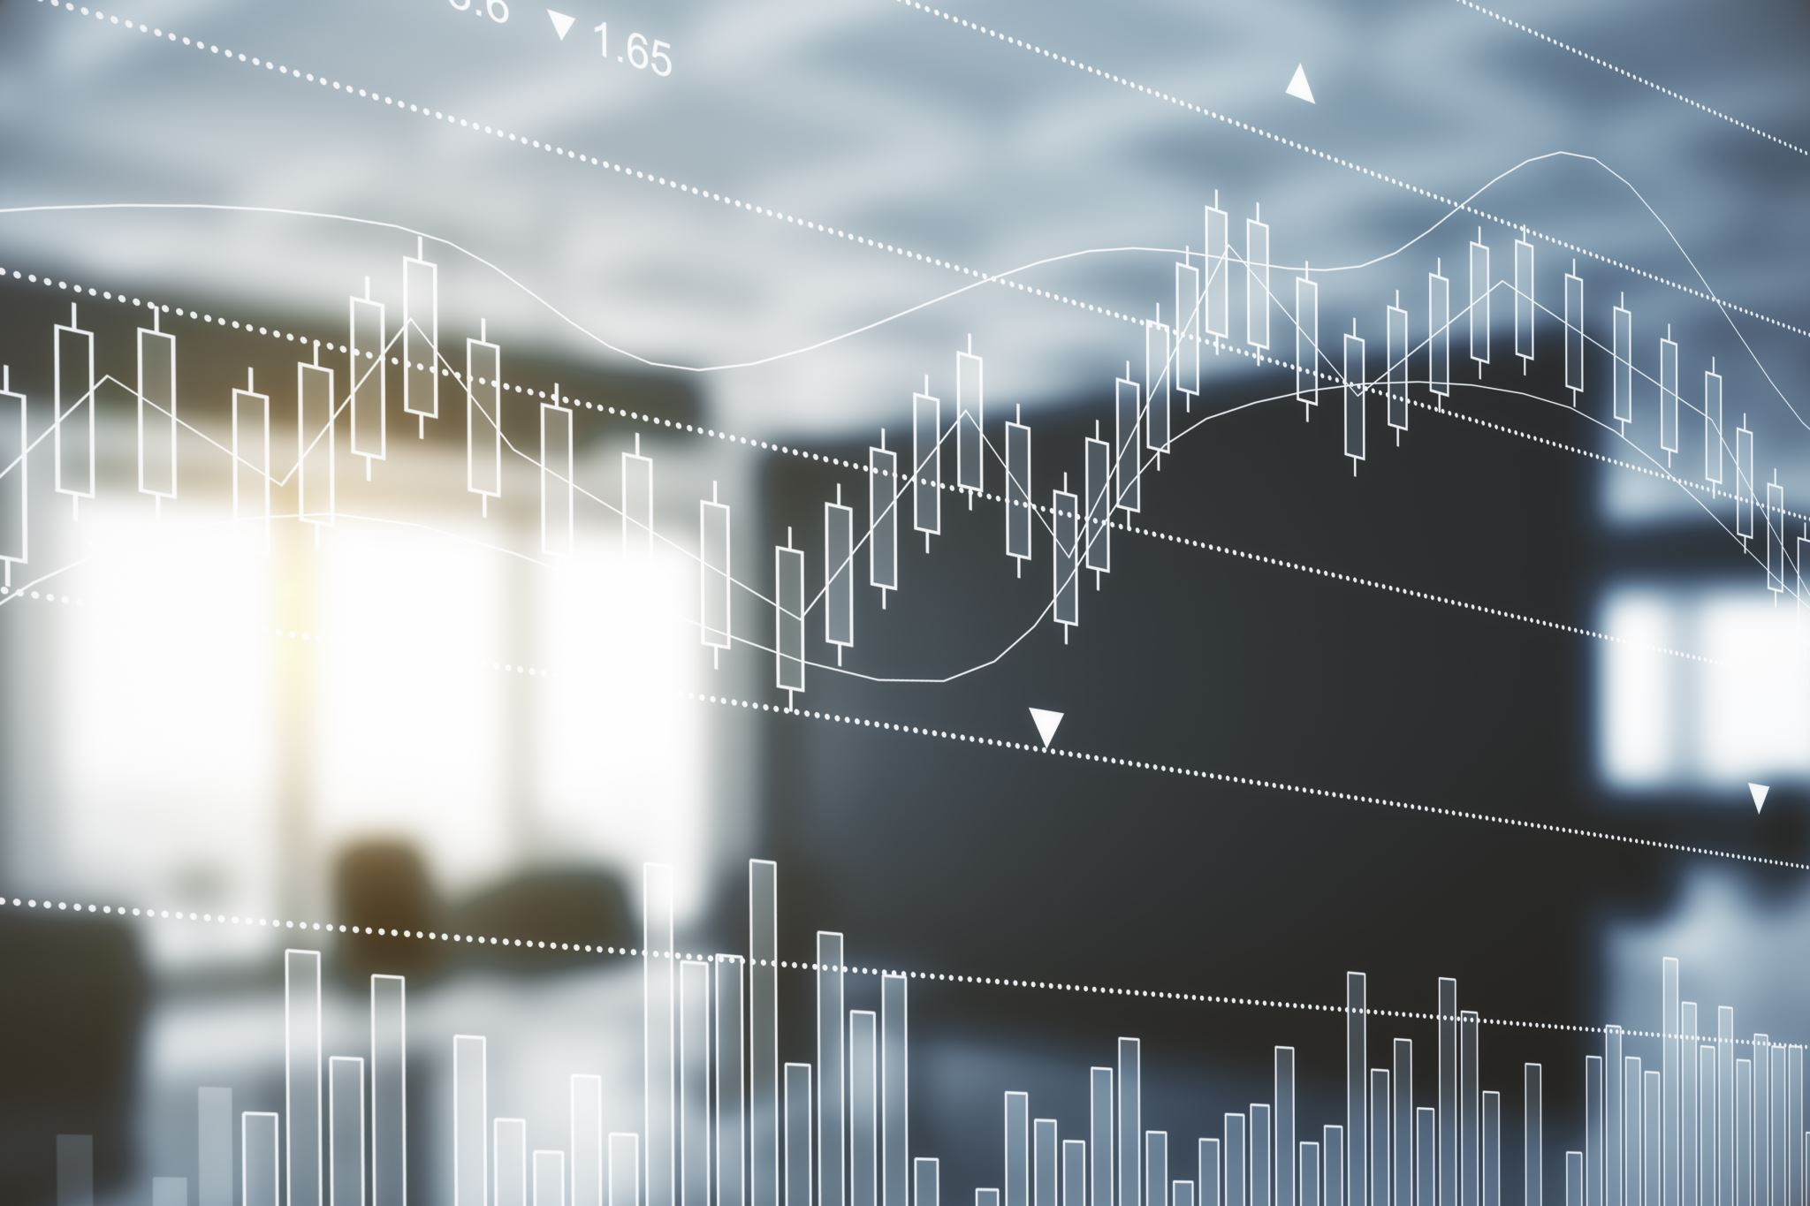




FUTURE SCOPE
Volatility analysis is crucial for risk assessment, aiding traders in sizing positions and managing risk.
More Technical indicators can be added & model can capture complex patterns and relationships in the data for better predictions.
Integration of some other Deep Learning methods alongside LSTM-GRU for real-time, accurate buy/sell signals in Nifty-50 option trading.

Slide 37
References
[1] (Islam, & Hossain, 2021). Foreign exchange currency rate prediction using a GRU-LSTM hybrid network. Soft Computing Letters, 3, 100009. https://doi.org/10.1016/j.socl.2020.100009
[2] (Mehtab et al, 2021). Stock price prediction using machine learning and LSTM-Based deep learning models. In Communications in computer and information science (pp. 88–106). https://doi.org/10.1007/978-981-16-0419-5_8
[3] (Jafar et al, 2023). Forecasting of NIFTY 50 Index Price by Using Backward Elimination with an LSTM Model. Journal of Risk and Financial Management, 16(10), 423. https://doi.org/10.3390/jrfm16100423
[4] (Chauhan et al, 2023). Stock price forecasting using PSO hypertuned neural nets and ensembling. Applied Soft Computing, 147, 110835. https://doi.org/10.1016/j.asoc.2023.110835
[5] (Fathali et al, 2022). Stock Market Prediction of NIFTY 50 Index Applying Machine Learning Techniques. Applied Artificial Intelligence, 36(1). https://doi.org/10.1080/08839514.2022.2111134
[6] (Chowdhury et al, 2024). Deep Learning Models for Stock Market Forecasting: A Comprehensive Comparative Analysis. Journal of Business and Management Studies, 6(2), 95–99. https://doi.org/10.32996/jbms.2024.6.2.9
[7] (Ghosh et al, 2024). Deep Learning in Stock Market Forecasting: Comparative analysis of neural network architectures across NSE and NYSE. Journal of Computer Science and Technology Studies, 6(1), 68–75. https://doi.org/10.32996/jcsts.2024.6.1.8
[8] (Manu et al, 2020). Stock index prediction using artificial neural network and econometric model: The case of Nifty 50. International Journal of Advanced Science and Technology, 29(5), 3425-3437. https://www.researchgate.net/publication/350037462_Stock_Index_Prediction_using_Artificial_Neural_Network_and_Econometric_Model_The_case_of_Nifty_50
[9] Code/Data Link: https://www.kaggle.com/code/praveenchoudhary1217/stock-option-indicator/edit

Slide 38


